Slide 1
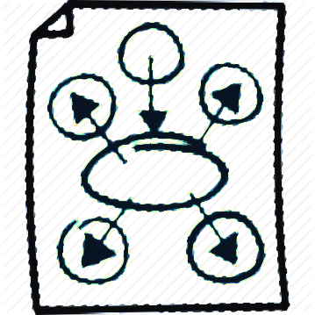

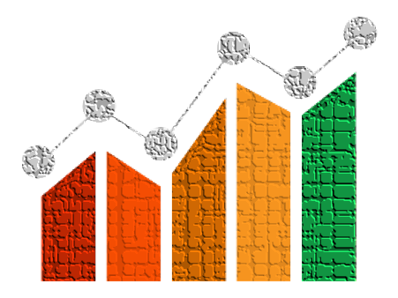
Course : ENTR6003 – Entrepreneurship 1
Year : September 2017
“Aligning VP
To Business Model (L)”
Session 12
F2F

Slide 2
LO 3: Assess the Value Proposition of the Created Business Idea
Learning Objectives

Slide 3
Sub Topics
Aligning Value Proposition to Business Model Process
Assessing the Business Model Design

Slide 4
Aligning Value Proposition to Business Model Process

Slide 5
From Value Proposition
to Business Model
The objective of this part is:
To practice how to connect the value proposition and business model
This action consists of two phase, Phase A, Design the Full Business Model, and Part B, Revisiting the Value Proposition

Slide 6



Part A:
Design the Full Business Model
A1: Frontstage
Prototype a revenue model, select distribution, channels and define the relationships that could be adopted with customers.
Your Business Idea
Your Business Idea
A2: Backstage
Add the Key Resources, Key Activities, and Partners required for the model to work and use that to estimate the cost structure.
A3: Assessment
Assess your prototype and detect possible weaknesses of the business model

Slide 7
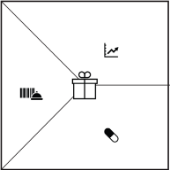
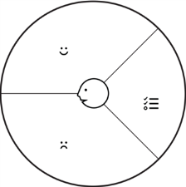
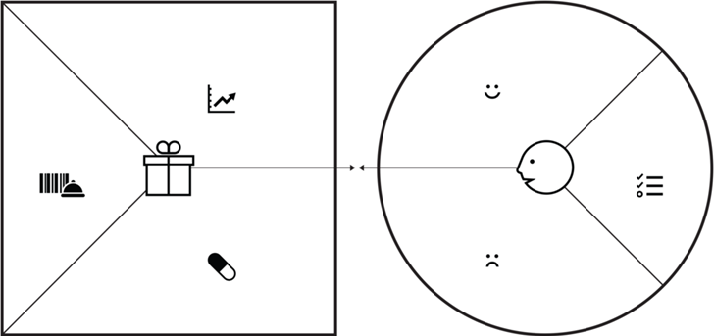
Part B:
Revisiting the Value Proposition
B4:
Change or Clear Your Benefits?
Do you need to change or clear the benefits your value proposition created because the customer profile changed?
B3:
Refine or Clear Your Profile?
Could you refine your Customer Profile. Or do you need to describe an entirely new one because you switched customer segments?
B5:
Got Fit?
Do you have fit between your new customer profile and the newly designed value propositions?
B1:
New VP?
Could there be another radically different VP for the same technology?
B2:
New Segment?
Will you keep the same CS, or shift to an entirely different, perhaps larger market segment?

Slide 8
Assessing the Business Model Design

Slide 9
7 Questions to Assess
The Business Model Design
Switching Costs – How easy or difficult is it for the customers to switch to another company?
Recurring Revenues – Is every sale a new effort or will t result in quasi-guaranteed follow-up revenues and purchases?
Earning vs Spending – Are your earning revenues before you are incurring costs?
Game-Changing Cost Structure – Is your cost structure substantially different and better than those of your competitors?
Others Who Dp the Work – How much does your business model get customers or third parties to create value for you for free?
Scalability – How easily can you grow without facing roadblocks – such as infrastructure, customer support, and hiring?)
Protection from Competition – How much is your business model protecting you from your competition?

Slide 10
References
Alexander O, Yves P, Greg B, and Alan S (2014), Value Proposition Design. John Wiley & Co, New Jersey. ISBN: 978-1-118-96805

